Slide 1
Parallel Shear Sort
By Michael Clausen, Jayson Doty, and Youssef Hegazy

Slide 2

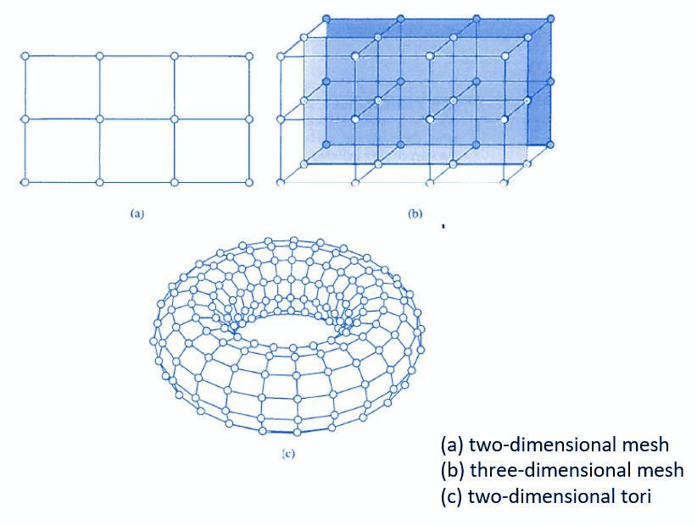
The Problem
Sorting large datasets efficiently.
Many institutions have collected huge amounts of data that may need to be sorted before analysis can occur.
Sequential sorting algorithms do not all scale well when applied to these large sets of data.
Sorting with a parallel architecture results in much faster computations.
Shear Sort is a parallel solution that is specifically used with 2-dimensional mesh architectures.

Slide 3
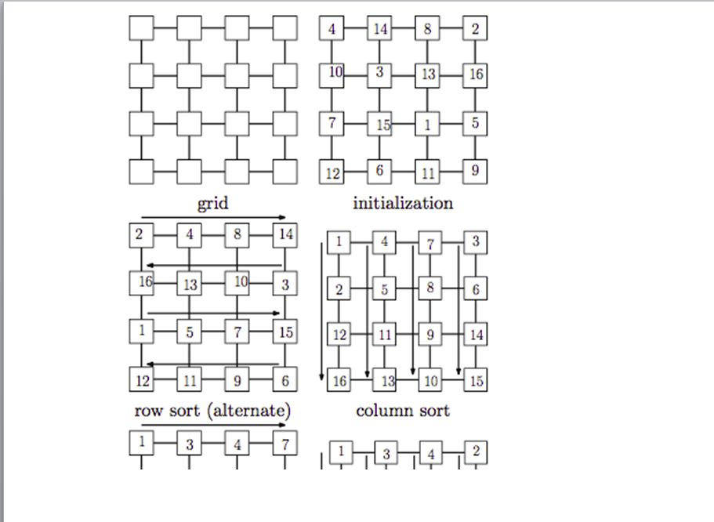
Shear Sort
Sort values on an N cell matrix
Perform the following steps log n times
Odd Stage - Sort odd rows from left to right and evens from right to left
Even Stage - Sort columns

Slide 4
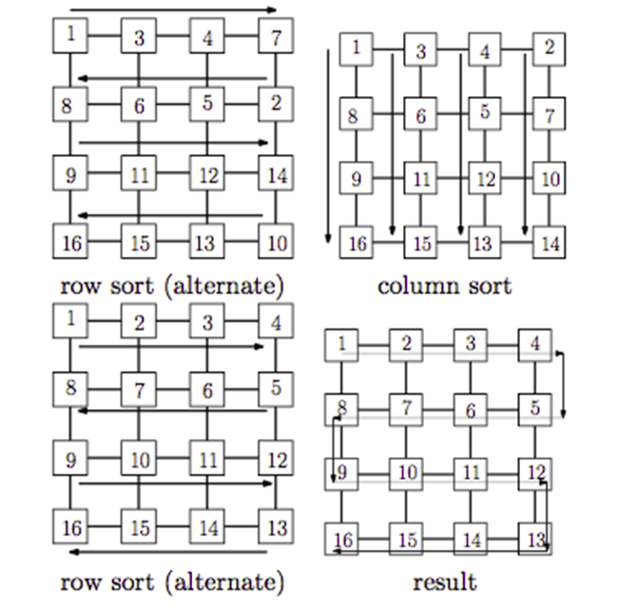
Shear Sort Contd.
We sorted the rows and the columns using Bubble Sort
The resulting matrix is sorted in a “snake like pattern”

Slide 5
Implementation
We used CUDA and wrote the program in C/C++.
We thought that this was a perfect problem to solve with CUDA as the platform allows you to instantly create matrices on the GPU
CUDA makes calculations upon these matrices intuitive.
The user enters the value for n and an n x n matrix is filled with random integers from -100 to 900.
The resulting matrix is sorted in a “snake like” pattern.

Slide 6
CUDA Commands Used
cudaMalloc()
cudaMemcpy
dim3 variables
__global__ KernelFunc<<<>>>()
cudaDeviceSynchronize()
cudaFree()
blockIDx, threadIDx, blockDim

Slide 7
Technical Difficulties
We had some trouble implementing the odd-even sorting sorting so we used Bubble Sort instead for the rows/columns.
How to divide the program up between host, global, and device functions.

Slide 8
Shortcomings
Only sorts square matrices, so the square root of the number of values must be a positive integer.
We haven’t found an upper limit for N so far.
Currently sorts values from -100 to 900 but this can be easily adjusted if needed.

Slide 9
Code Demonstration & Pseudocode
Main function:
Initialize N to 0.
Display a prompt for the user to enter an integer value for N greater than 0.
Get the value of N from user input.
While (N < 1):
Display a message that N must be greater than 0.
Get the value of N from user input again.
Declare a 2D array 'ha' with dimensions N x N.
Declare pointers 'dm' and 'd_count' for GPU memory.
// Initialize the matrix with random values and print it.
Display "Matrix before sorting" with a separator line.
For each row (i from 0 to N):
For each column (j from 0 to N):
Assign a random value to ha[i][j].
Display the value of ha[i][j] with proper formatting.
// Memory allocation and data transfer to GPU.
Allocate memory on GPU for 'dm' with size N x N.
Copy the matrix 'ha' from host to device memory.
Define the number of threads per block and the number of blocks.
Set threadsPerBlock to N and numBlocks to 1.
For (i from 0 to log2(N) + 1):
Launch the ShearSortRow kernel function with parameters 'dm' and 'N'.
Synchronize the device to ensure kernel execution is completed.
Launch the ShearSortColumn kernel function with parameters 'dm' and 'N'.
Synchronize the device again.
// Copy the sorted matrix back to the host and free GPU memory.
Copy the matrix 'dm' from device to host memory.
Free the memory allocated for 'dm' on the GPU.
// Print the sorted matrix.
Display "Matrix After sorting" with a separator line.
For each row (i from 0 to N):
For each column (j from 0 to N):
Display the value of ha[i][j] with proper formatting.
ShearSortRow function:
Calculate the threadID based on the block and thread indices.
If (threadID < matrix.size(n)):
Loop over the matrix rows (i from 0 to n):
Loop over the matrix columns (j from 0 to n-1):
Calculate the index in the matrix based on the threadID and column index.
If ( ( row%2==0 && element[index] > element[index+1)] ) or (row %2==1 && element[index] < element[index+1]) )
swap the elements
ShearSortColumn function:
Calculate the threadID based on the block and thread indices.
If (threadID < matrix.size(n)):
Loop over the matrix rows (i from 0 to n):
Loop over the matrix columns (j from 0 to n-1):
Calculate the index in the matrix based on the column index and threadID.
If ( element[index] > element[index+1] )
swap the elements.

Slide 10
Thank You

Slide 11
Image Sources
Dr. Bein. Lecture1_Introduction and Lecture11_Parallel_Sorting
Meir, Avi. Big Data in the Cloud - A Comprehensive Guide, https://www.ridge.co/blog/big-data-in-the-cloud-a-comprehensive-guide/

